Slide 1

The W3C Linked Building Data Community Group
Chairs:
Kris McGlinn, Trinity College Dublin
Georg Ferdinand Schneider, Schaeffler Technologies AG & Co. KG
Maxime Lefrançois, MINES Saint-Étienne, France
Mads Holten Rasmussen, NIRAS

Slide 2
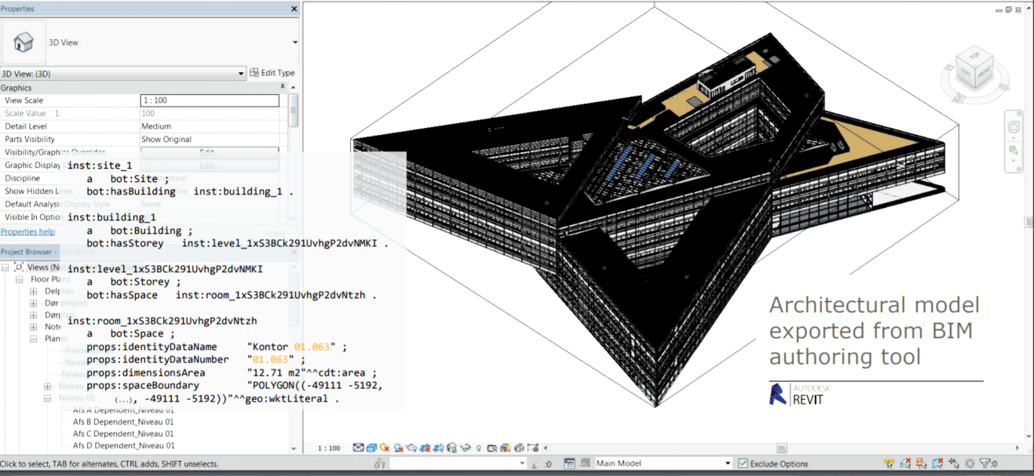
Building Information Modelling (BIM)

Slide 3
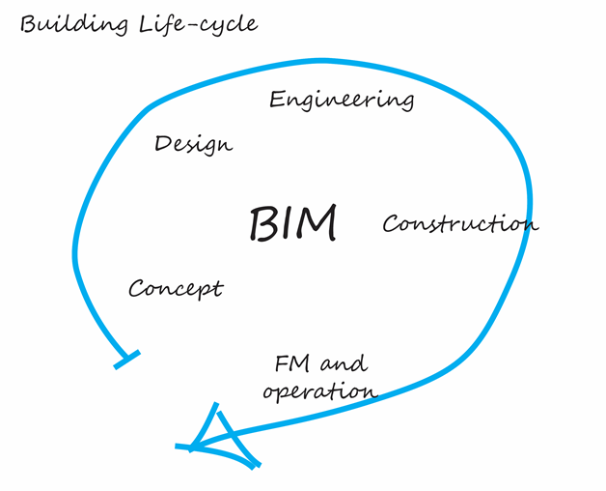
Building Life Cycle

Slide 4
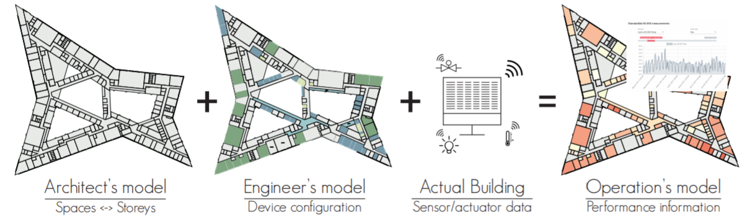
Building Life Cycle

Slide 5
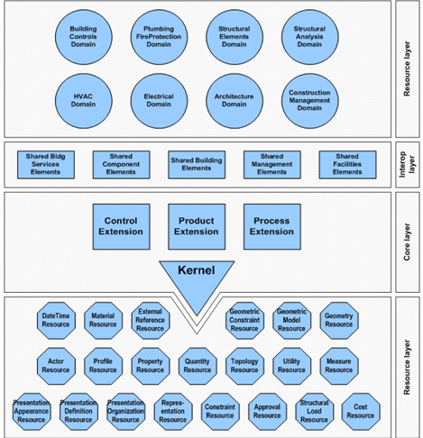
Industry Foundation Classes (IFC)
There exists a standard, but:
not modular
not extensible
not simple enough to use
AND not Web-compliant !

Slide 6
OUTLINE
Who we are
What is our mission
What we produce
Where we head at (and who supports us)

Slide 7
WHO WE ARE

Slide 8
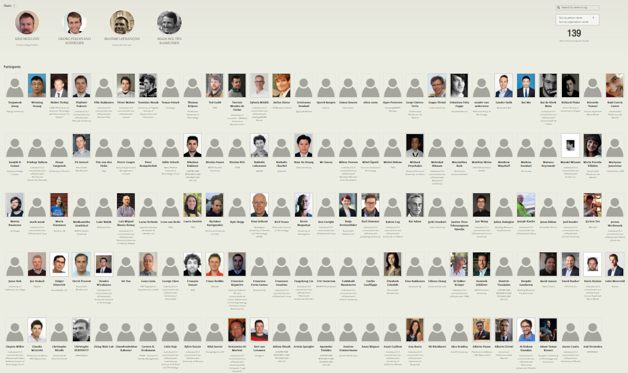
Who we are (2020)
started Dec. 2014 now 143 participants 18th biggest W3C CG

Slide 9
How we work
Public mailing list
Regular online calls (every 2 weeks), minutes public, joint note-taking
Public GitHub organisation https://github.com/w3c-lbd-cg
Laisons with other groups and initiatives : BuildingSMART, ETSI SmartM2M, OGC, AFNOR, CEN, ISO, RealEstateCore, AIOTI WG3, ASHRAE 223 Semantic Interoperability, Brick Schema, AACE International, German expert groups "BIM und Holzbau" ("BIM and wood") and "Stahlbauforum" ("Steel construction")
W3C entrypoint: https://www.w3.org/community/lbd/
Group entrypoint: https://w3c-lbd-cg.github.io/lbd

Slide 10
WHAT IS OUR MISSION
Bring together experts in the area of Building Information Modeling (BIM), , who are working to address the challenge of managing the huge amount of data that is generated across the building life cycle.
We want to provide a forum for bringing together researchers and practitioners who are working on advancing the field.

Slide 11
life cycle of a building
Vast amounts of heterogeneous data are generated and used during the life cycle of a building. An example is product data, which describe the building and the elements that make up the building. Product data includes walls, windows, pipes, ducts, light switches, sensors and other devices. With these data as a basis, and through their connection to more fine-grained data, such as sensor measurements data, usage data, intelligent domotic system data, geographical data, weather data, highly advanced services can be supplied over the Web to various end users.

Slide 12
industrial point of view
From an industrial point of view, using Linked Data technologies and adopting common Knowledge Graph models are essential to exploiting building data on the web for a range of important use cases, including those related to indoor navigation (e.g. shop navigation, evacuation and disaster, etc.), energy efficiency simulation (e.g. retrofitting, behavioural change, etc.), web-based facility management, and many more.

Slide 13
The 5 stars Linked Data paradigm
Using URIs as names for building-related things such as: rooms, walls, products, elements, enable different parties to provide complementary descriptions of the same uniquely identified entities in different knowledge graphs.
Using HTTP URIs for these things enables the authority responsible for these URIs to provide reference information about this entity when one looks it up on the Web. For example, products in a catalogue, building appliances, or even the building itself.
Providing information using common standards (RDF, SPARQL) and common Knowledge Graph models enable semantic interoperability between data sources.
Include links to other URIs can help to discover more things, such as a link to the catalogue an appliance has been chosen from, or a link to the Web of Things Servient that enables it to interact with this appliance.

Slide 14
WHAT WE PRODUCE
We actually do work ;)

Slide 15
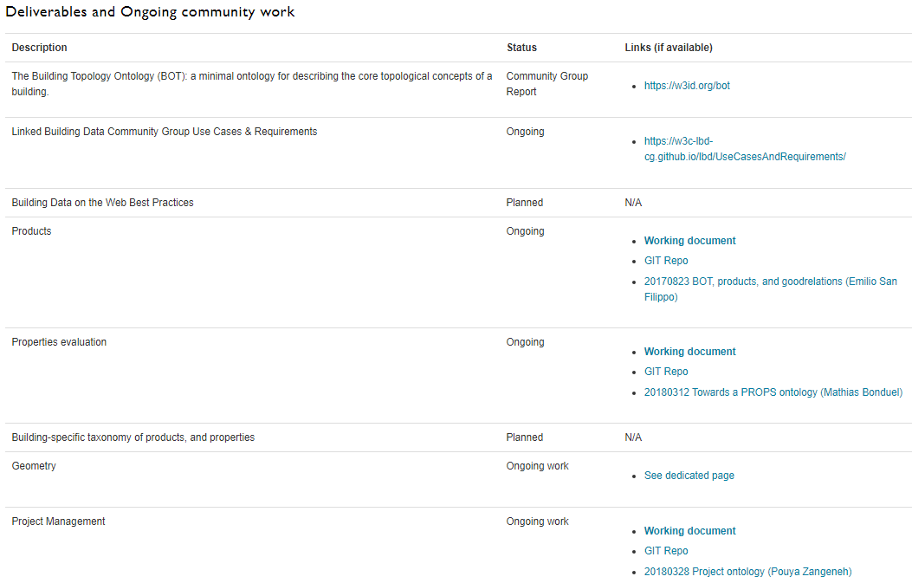
(From https://w3c-lbd-cg.github.io/lbd/ )

Slide 16
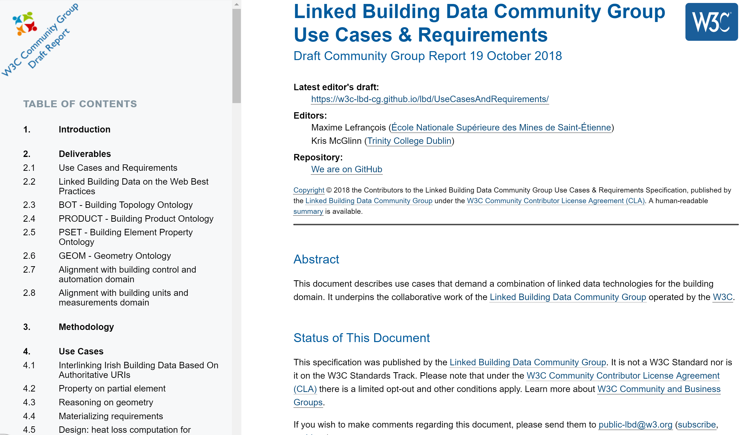
overview of the structure of the document
(at https://w3c-lbd-cg.github.io/lbd/UseCasesAndRequirements/ )
Comprehensive use case gathering is conducted across the LBD community, and also wider research and industrial communities (as part of the h2020 SWIMing project)
Used to identify deliverables and their scope in the charter
Currently 54 use cases, 7 requirements

Slide 17

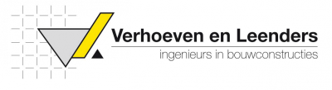










Use cases in practice
Further to these use cases, we strongly support and encourage active practitioners to perform reference implementations and active tests.

Slide 18
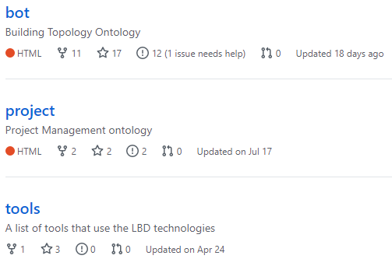
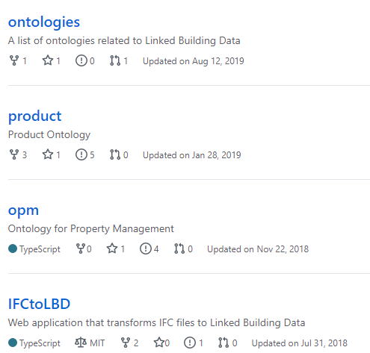
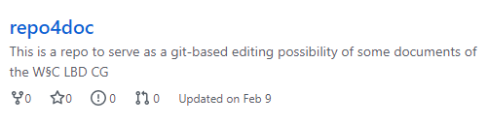
Other repositories

Slide 19
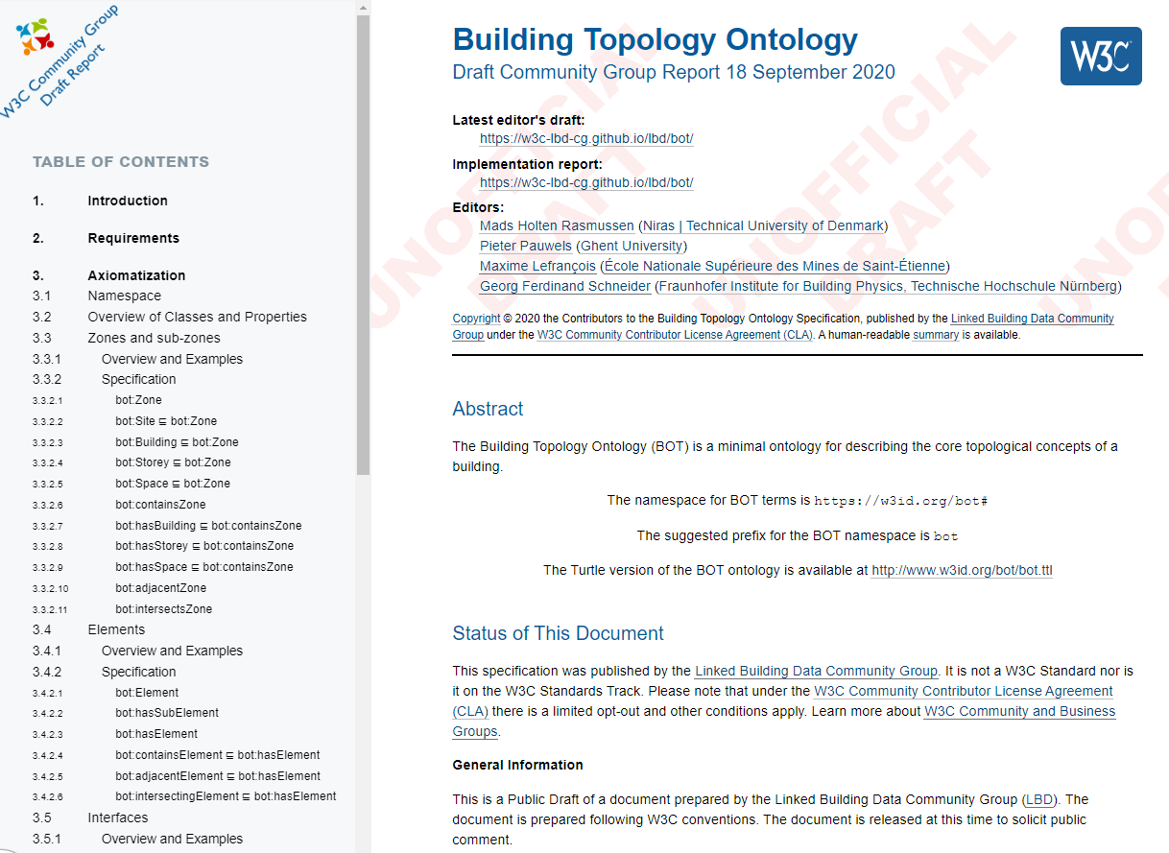
BUILDING TOPOLOGY ONTOLOGY
overview of the structure of the document (at https://w3id.org/bot/ )
Mads Holten Rasmussen, Maxime Lefrançois, Georg Ferdinand Schneider, Pieter Pauwels (2020). BOT: the Building Topology Ontology of the W3C Linked Building Data Group, Semantic Web Journal, IOS Press

Slide 20
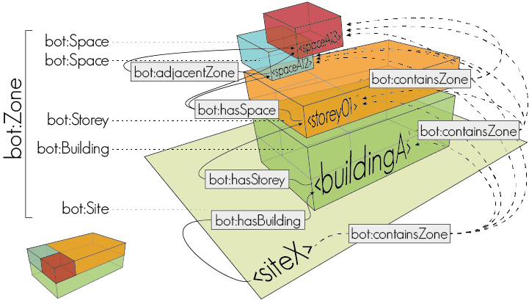
Building topology ontology

Slide 21
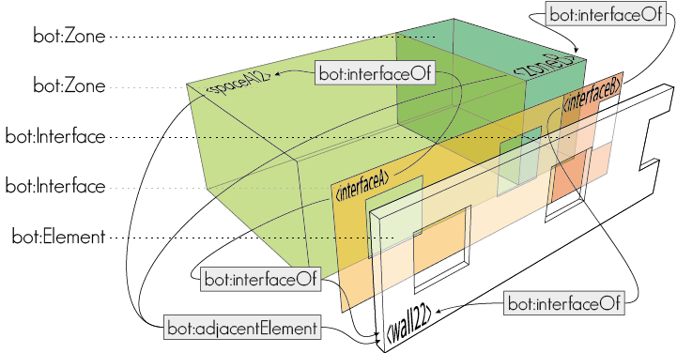
Building topology ontology

Slide 22
Questions?

Slide 23
WHAT WE PRODUCE
We actually do work ;)

Slide 24
FEATURE OF INTEREST – Property - value
Not only the Building domain describes FoI - Property - Value
W3C standards and initiatives
SOSA/SSN
WoT TD
Automotive WG
External standards
ETSI SAREF
schema.org
BSDD
relevant also outside the building domain
not always RDF

Slide 25
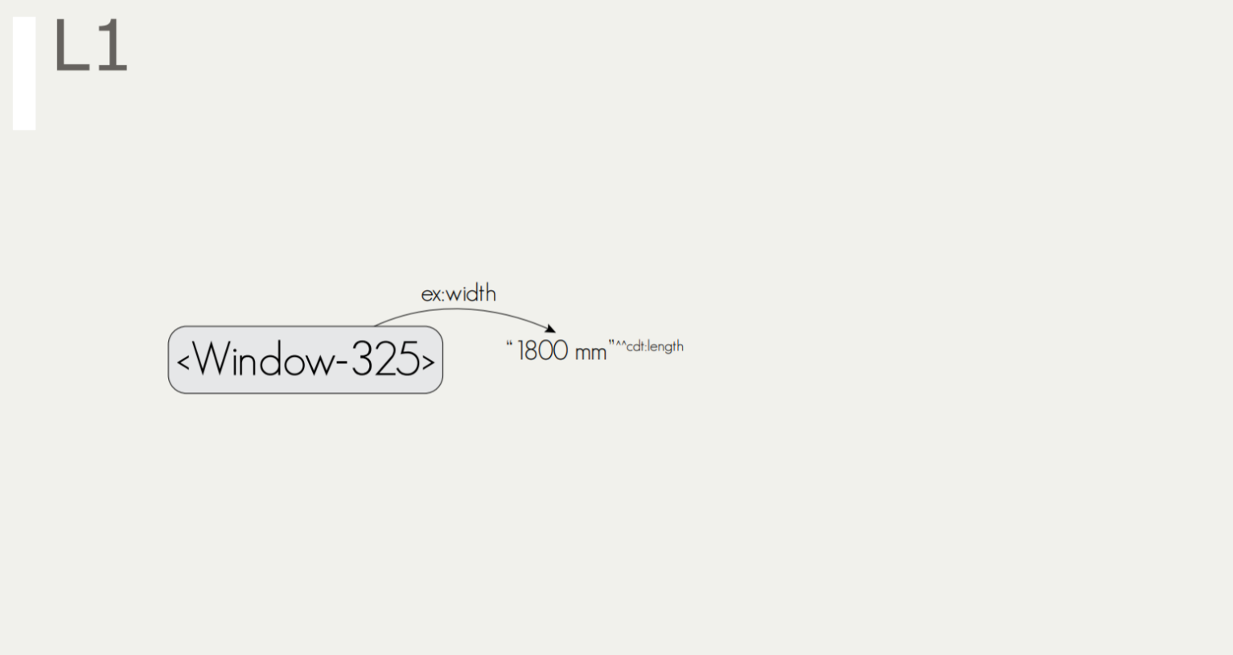
FEATURE OF INTEREST – Property - value

Slide 26

CDT: Custom Datatypes
cdt:ucum is not a product of the group, no discussions to endorse it, but useful
(https://w3id.org/lindt/custom_datatypes#ucum)
"20.7 Cel"^^cdt:ucum
“68.4 %"^^cdt:ucum
"450 lm"^^cdt:ucum
"27.1 ug.m-3"^^cdt:ucum
"142 [ppm]"^^cdt:ucum
"276 W"^^cdt:ucum
"1013.25 hPa"^^cdt:ucum
"1.01325e5 Pa"^^cdt:ucum
"102 m2"^^cdt:ucum
“52 a"^^cdt:ucum
"0.27 W/(m2.K)"^^cdt:ucum
"33 cL"^^cdt:ucum
"0.7 L"^^cdt:ucum
"0 [mi_i]/h"^^cdt:ucum
"0 m.s-1"^^cdt:ucum
"0 km/h"^^cdt:ucum
"4.31 bar"^^cdt:ucum
Figure 1. Two cdt:ucum adopters sitting at a table
@prefix cdt: <http://w3id.org/lindt/custom_datatypes#>.

Slide 27
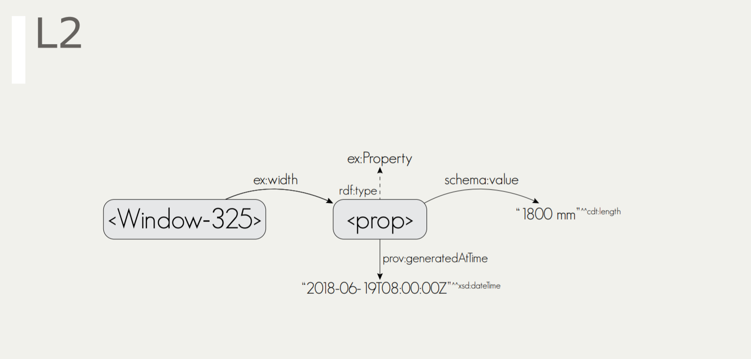
FEATURE OF INTEREST – Property - value

Slide 28
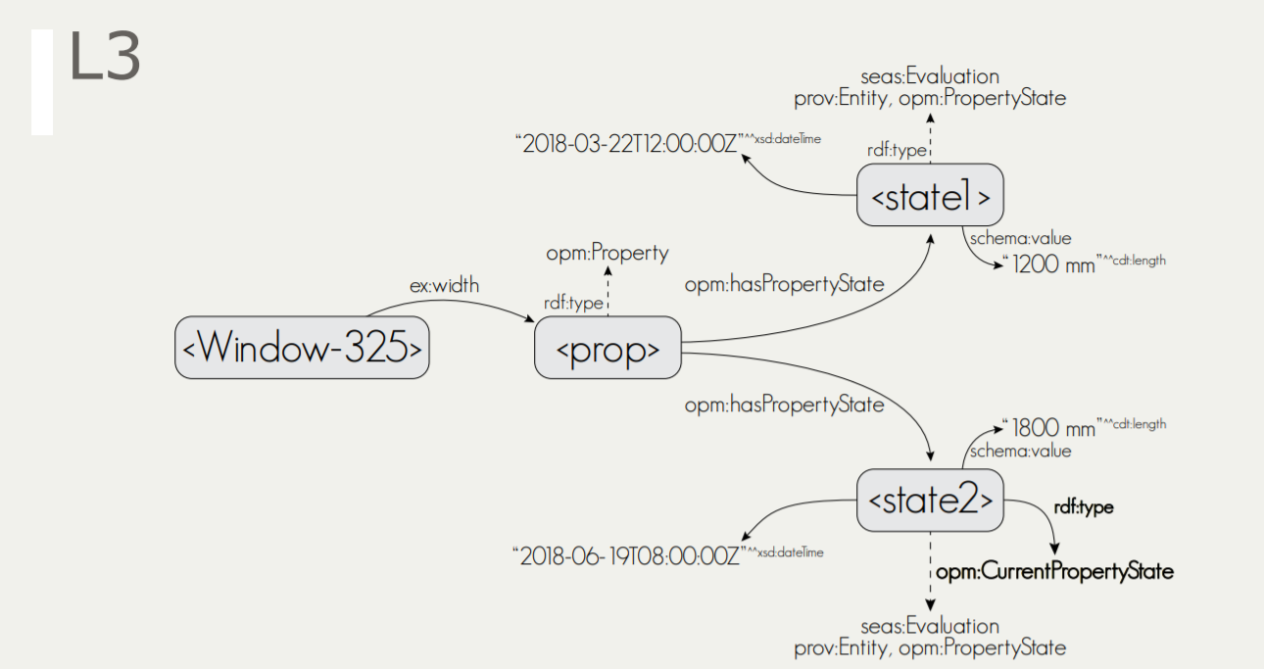
FEATURE OF INTEREST – Property - value

Slide 29
FEATURE OF INTEREST – Property - value
Questions:
Equivalences?
Inference / entailment regime?
Support in RDFS / OWL 2 profiles?

Slide 30
PRODUCTS & PROPERTY EVALUATION
Individual products * (with serial number)
Generic Product *
Manufacturer Products *
Product category
Product placeholder
* also in schema.org
Observation *
Actuation *
Measured Value
Desired Value
Computed Value
Rated Operating Value
…
* also in W3C SOSA/SSN

Slide 31
PRODUCTS & PROPERTY EVALUATION
Reasoning with Products and their properties:
Some use cases require the value of a property of a generic product can be inherited / overridden by a specific product
Validating Products and their properties:
Some use cases require to be able to check conformance of products with respect to requirements

Slide 32
THE overall FoI – product – props model
Domain-independent
Aimed to be a W3C Recommendation
Supported by W3C Group Notes that show domain-specific example taxonomies (see next slides)
All to be documented in the Building Data on the Web Best Practices

Slide 33
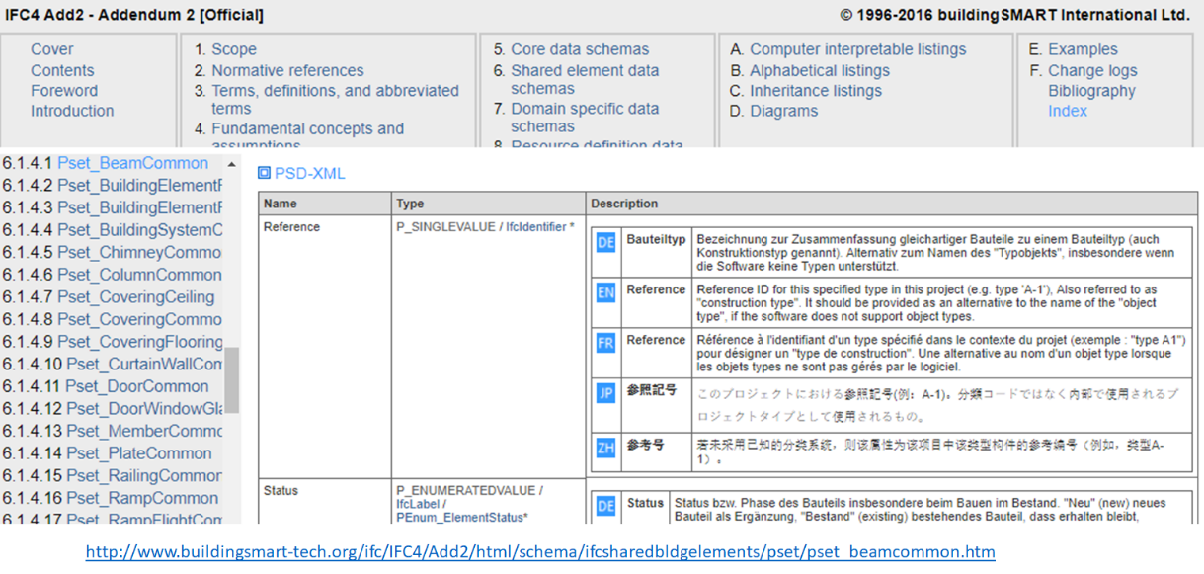
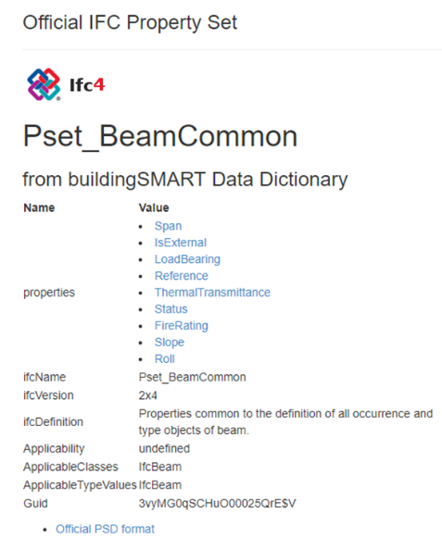
Need for domain-specific taxonomies
We are the linked <building> data group
e.g. CCS, SfB, BuildingElements in IFC, …

Slide 34
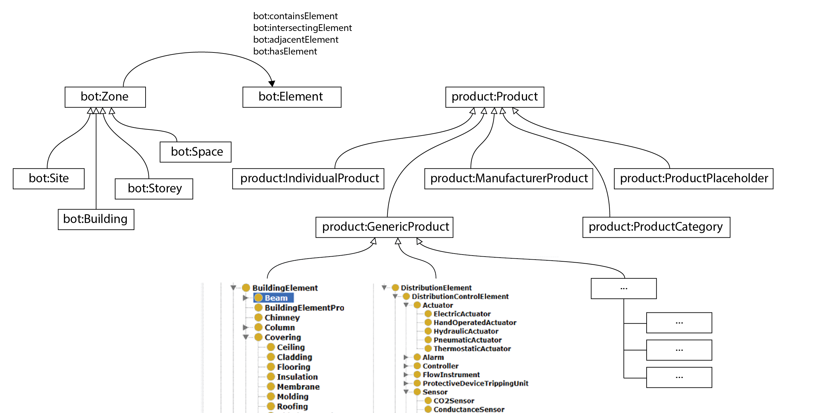
OVERALL STRUCTURE
GoodRelations
inst:Wall_X
Schema.org
rdf:type
rdf:type
geom
geo

Slide 35
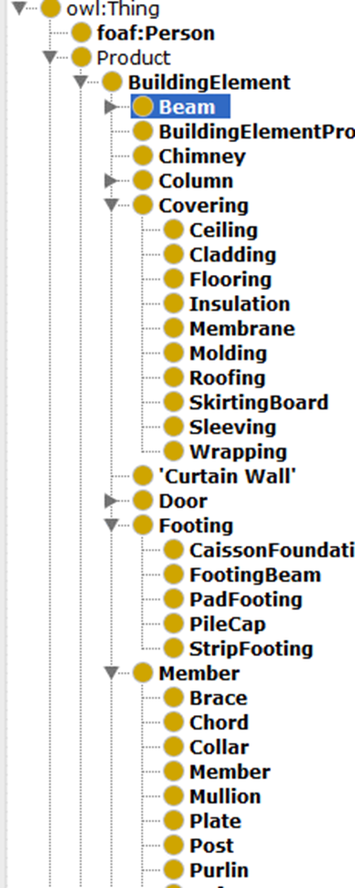
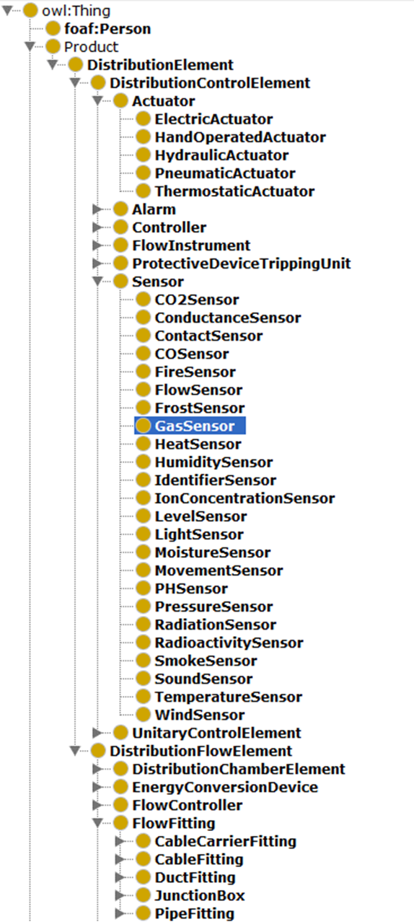
Example taxonomy: IfcProduct ontology

Slide 36
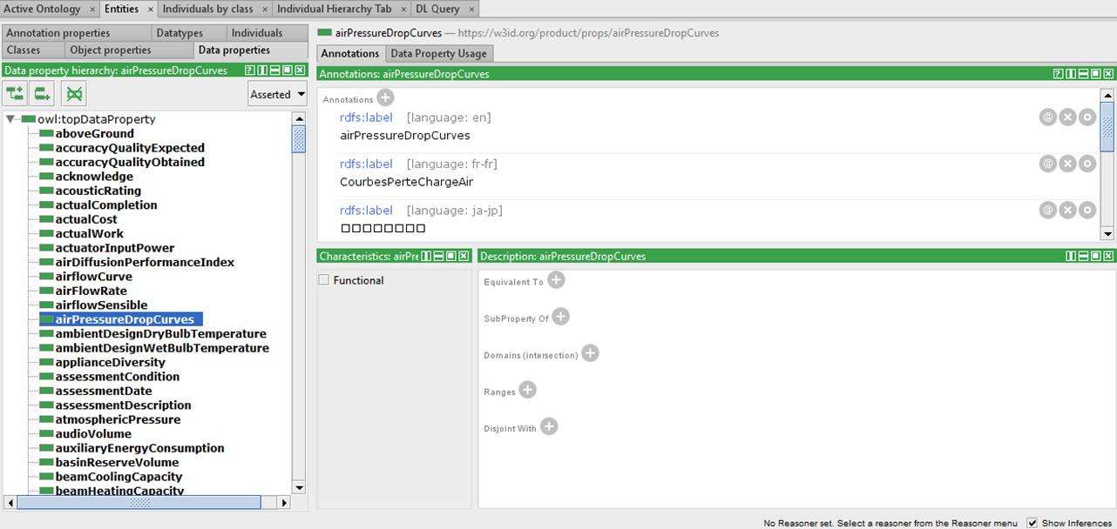
EXAMPLE TAXONOMY: ifcProps ontology

Slide 37
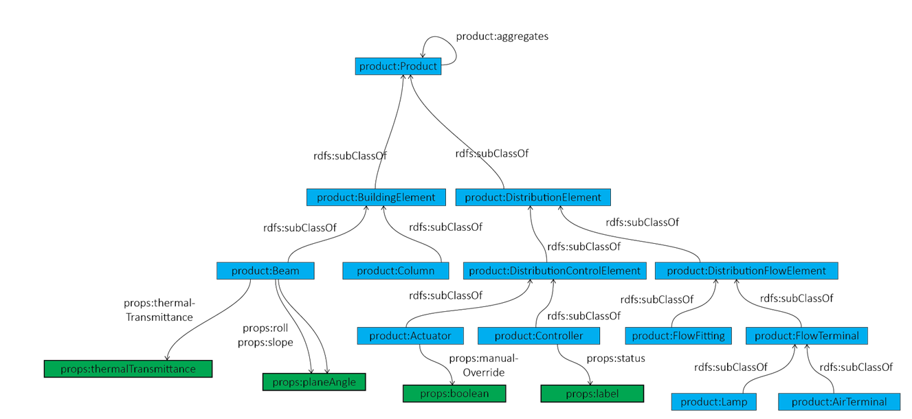
Links between the IFCPROPS and IFCPRODUCT ontology

Slide 38
Questions? (5 mins)

Slide 39
Alignments and Links
We don't use the close world assumption ;-)

Slide 40




Existing Vocabularies/Standards for Building Data
W3C | buildingSmart International | OGC | ISO | Other
SSN (Semantic Sensor Networks) | ifcOWL | GML (Geography Markup Language) -> ISO 19136:2015 | Data structures for electronic product catalogues for building services -- Part 1: Concepts, architecture and model (ISO 16757-1:2015) | DogONT (Ontology Modeling for Intelligent Domotic Environments)
owl-time | ISO 29481 Building information models -- Information delivery manual (IDM) | CityGML | Geographic Information - Spatial Schema (ISO 19107:2003) | SAREF (Smart Applications REFerence Ontology)
JSON-LD (JavaScript Object Notation for Linked Data) | ISO 12006 Building construction -- Organization of information about construction works | CityGML Building Module | OWL representation of part of the model for geometry and space from ISO 19107:2003 (ISO 19150-2) | Ontology of Spatial Relations (defined by the UK Ordnance Survey)
BasicGeo | ISO 12006-2 Framework for classification | GeoSPARQL |  | GeoVocab Geometry and Spatial Ontology
SOSA (Sensor, Observation, Sample, and Actuator) ontology | ISO 12006-3 Framework for object-oriented information (IFD) | Indoor GML |  | SmartEnergy Aware Systems (SEAS)
 | Industry Foundation Classes (ISO 16739:2013) | SensorML (OpenGIS Sensor Model Language) |  | Brick
 |  | SWE (Sensor Web Enablement) Common Data Model |  | Project Haystack
 |  |  |  | RealEstate Ontology
Original slide by Ana Roxin
Notes:
http://schemas.opengis.net/

Slide 41
Alignments for BOT (by Georg Ferdinand Schneider)
Outgoing links
Incoming links
BOT Resource URI | Predicate | Aligned Resource URI
bot:Zone | rdfs:subClassOf | brick:Location
bot:Zone | rdfs:subClassOf | dogont:Environement
“The Building Topology Ontology (BOT) is a simple ontology defining the core concepts of a building.”
Aligned Resource URI | Predicate | BOT Resource URI
brick:Building, dogont:Building, dogont:Flat, ifc:IfcBuilding, rooms:Building | rdfs:subClassOf | bot:Building
brick:Equipment, brick:Point, dogont:Controllable, dogont:Device, dogont:UnControllable, dogont:TechnicalSystem ifc:IfcElement, rooms:Desk | rdfs:subClassOf | bot:Element
ifc:IfcSite, rooms:Site | rdfs:subClassOf | bot:Site
brick:Basement, brick:Outside, brick:Room, brick:Space, brick:Wing, brick:Zone, dogont:Room, ifc:IfcSpace, rooms:Room | rdfs:subClassOf | bot:Space
brick:Floor, dogont:Storey, ifc:BuildingStorey, rooms:Floor, rooms:FloorSection | rdfs:subClassOf | bot:Storey
dogont:BuildingEnvironement | rdfs:subClassOf | bot:Zone
brick:contains | rdfs:subPropertyOf | bot:containsElement
dogont:hasWallOpening | rdfs:subPropertyOf | bot:hosts
rooms:contains | rdfs:subPropertyOf | bot:containsZone
bot: https://w3id.org/bot#
brick: https://brickschema.org/schema/1.0.2/Brick#
dogont: http://elite.polito.it/ontologies/dogont.owl#
ifc: http://www.buildingsmart-tech.org/ifcOWL/IFC4_ADD2#
rdfs: http://www.w3.org/2000/01/rdf-schema#
rooms: http://vocab.deri.ie/rooms#

Slide 42
LINKING GEOSPATIAL & GEOMETRY TO BOT
Geometry is an important part of BIM
Many different types of geometry, with different standards to meet the requirements of different use cases
No approach or standard is generally superior to others.
BOT provides a simplified (compared with other available standards, e.g. IFC) method for interlinking non-geometric data with multiple geometry representations, to address use cases.
GIS Application
CAD Application
CAD Application
Export
2D Geospatial
Geometry
3D Geometry
(Simplified Tessellated)
3D Geometry
(Detailed Semantic)
Import
Use Case 3
Use Case 1
Use Case 2

Slide 43
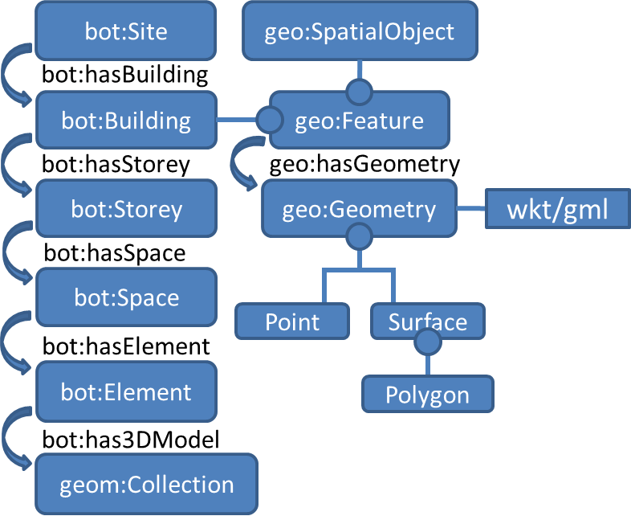
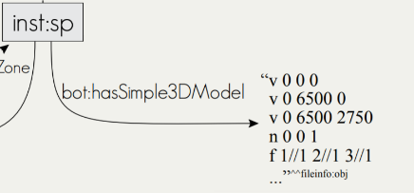
LINKING geospatial & GEOMETRY TO BOT
For Simple geolocation
bot:hasZeroPoint links to wsg84:Point
For 2D geospatial data
bot:Building is a subclass of geo:Feature, and can have geometry, which can be expressed as GeoSPARQL WKT.
For 3D geometry
bot:hasSimple3DModel links to a literal that encodes 3D geometry (e.g., OBJ model) bot:has3DModel links to a blank node or IRI that further describes the 3D geometry with another vocabulary (e.g., the Geom ontology - http://rdf.bg/geometry.ttl )

Slide 44
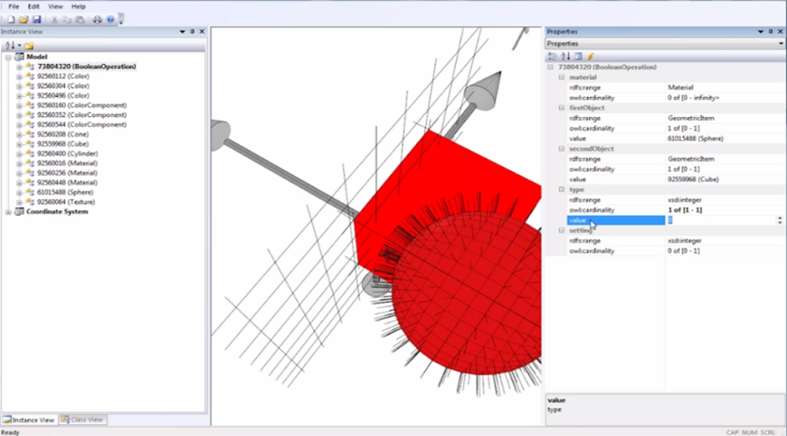
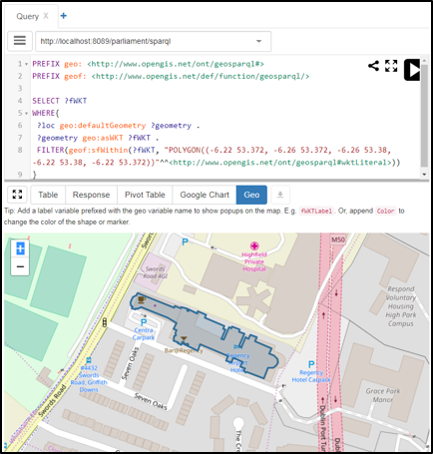
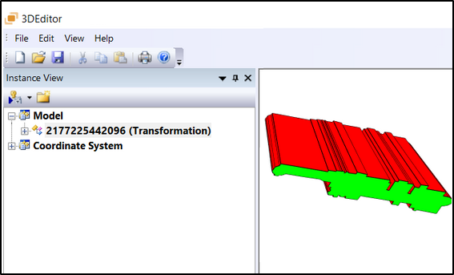
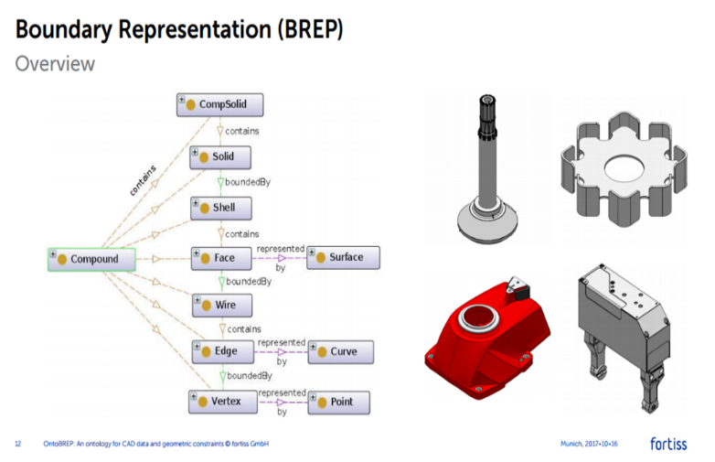
External ontologies for 2D & 3D geometry
Geom – 2.5D & 3D
OntoBREP
- 3D
GeoSPARQL – 2D Geospatial

Slide 45
Questions? (5 mins)

Slide 46
LIAISONS
Looking for collaborations and integration outside our group

Slide 47
Links to other W3C groups
W3C
Interest Groups
Automotive
(V2Building?)
Data Exchange
Schema.org
Automotive ontology
Blockchain
Community Groups
Dataset Exchange
Web of Things
Working Groups
Web of Things
Spatial Data on the Web
Notes:
https://www.w3.org/2017/12/odi-study/#rdf
CSVW - https://www.w3.org/community/csvw/
Devices and Sensors WG
https://www.w3.org/das/roadmap
Web of Things
WoT & OGC Sensorthings API
JSON-LD
Spatial Data on the Web IG
CityJSON
CovJSON
SSN extensions
SSN / SOSA
Web of Things IG

Slide 48
Links to existing Standardisation Groups
ISO/DIS 21597 Information Container for Data Drop
ISO/DIS 23262 GIS and BIM interoperability
buildingSmart Data Dictionary (bSDD)
Linked Data Working Group (LDWG)
French national plan for buildings’ digital transition
Dictionary of properties
CEN TC 442 Building Information Modelling – WG4 Support Data Dictionaries
ETSI – Smart Appliances Reference ontology (SAREF)
American Society of Heating, Refrigerating and Air-Conditioning Engineers BRICK - http://brickschema.org
Notes:
four of the main developers of SAREF are members of LBD-CG

Slide 49
Questions? (5 mins)

Slide 50
Implementations and Tools
Why it's worth for the industry

Slide 51
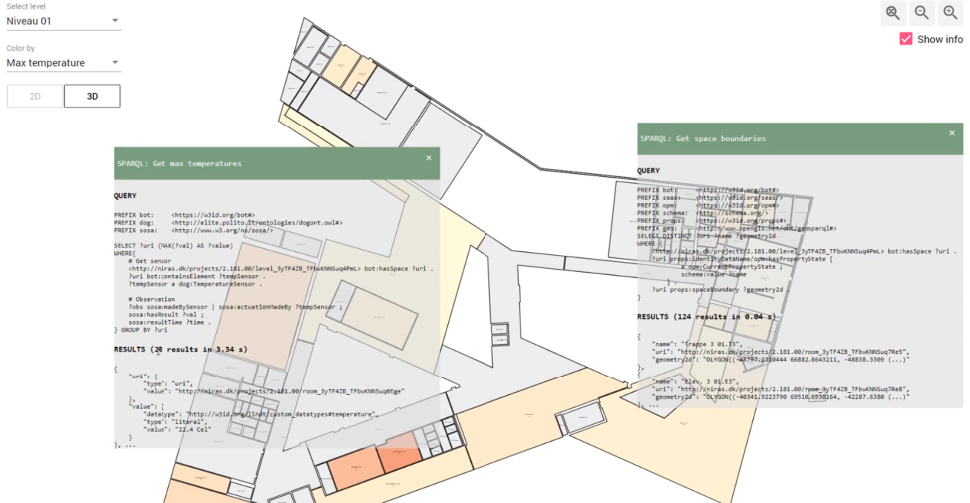
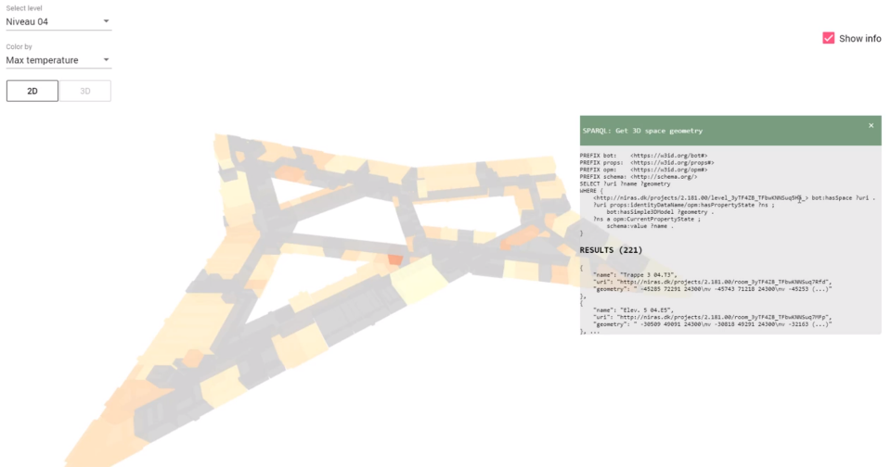
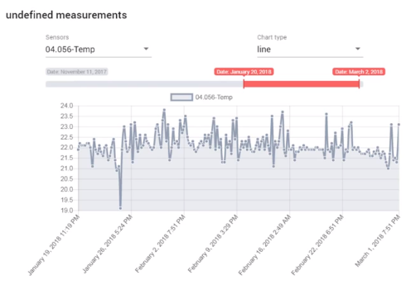
BOT + SOSA + geometry
https://youtu.be/P_38gIvrbmg

Slide 52
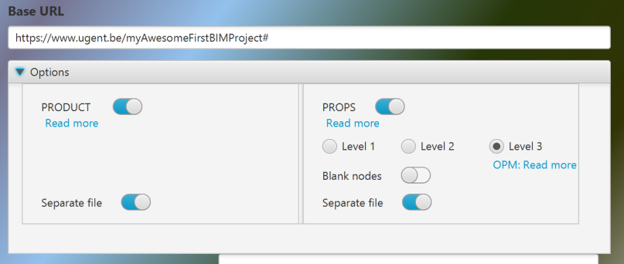
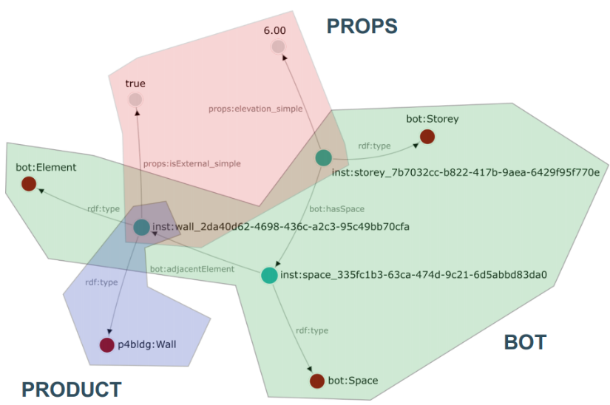
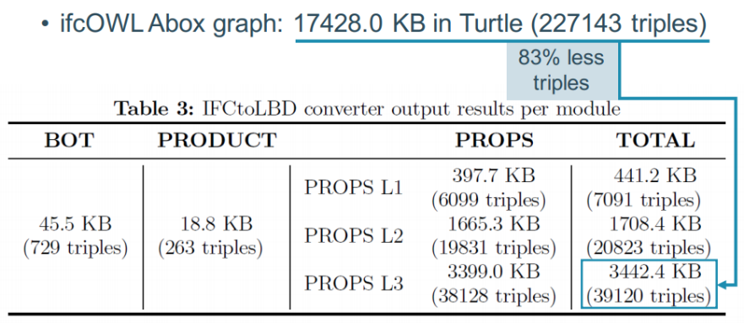
IFCtoLBD converter
https://github.com/jyrkioraskari/IFCtoLBD

Slide 53
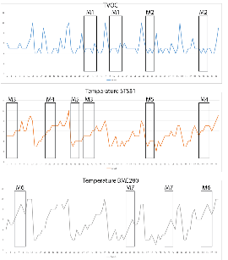
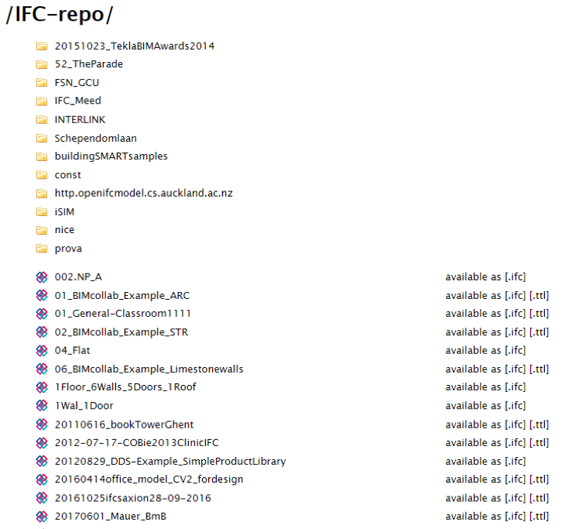
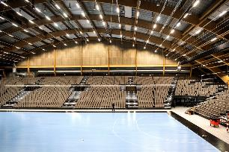


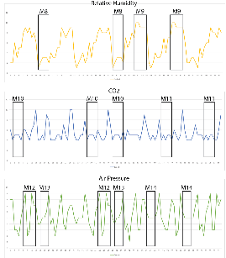

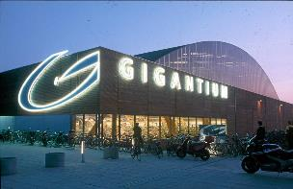
IMPLEMENTATION @GiGANTIUM DENMARK - Combination with sensor data
Repo of 531 LBD building graphs
36 million triples in total
372 bot:Building instances
3,523 bot:Zone instances
2,117 bot:Space instances
615,452 bot:Element instances
converted from http://smartlab1.elis.ugent.be:8889/IFC-repo/
to LBD using https://github.com/jyrkioraskari/IFCtoLBD

Slide 54
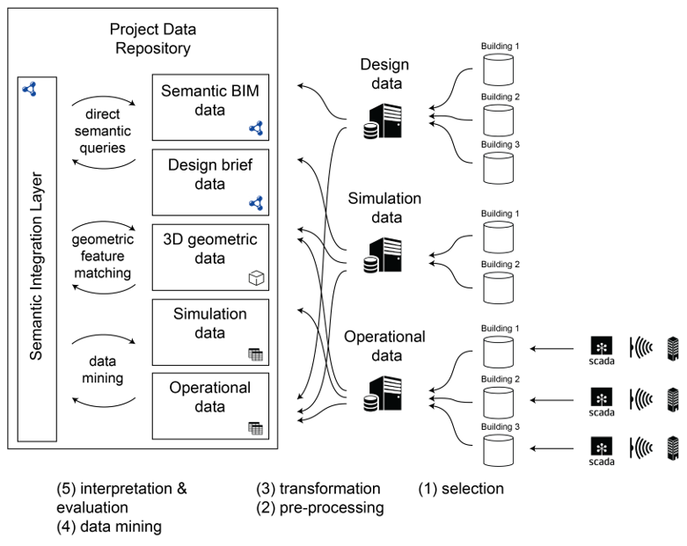
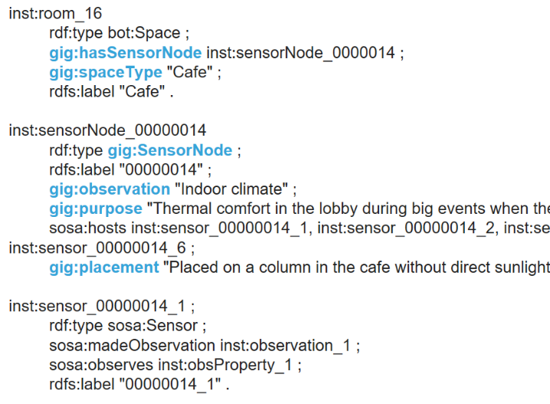
IMPLEMENTATION @GiGANTIUM DENMARK - Combination with sensor data

Slide 55
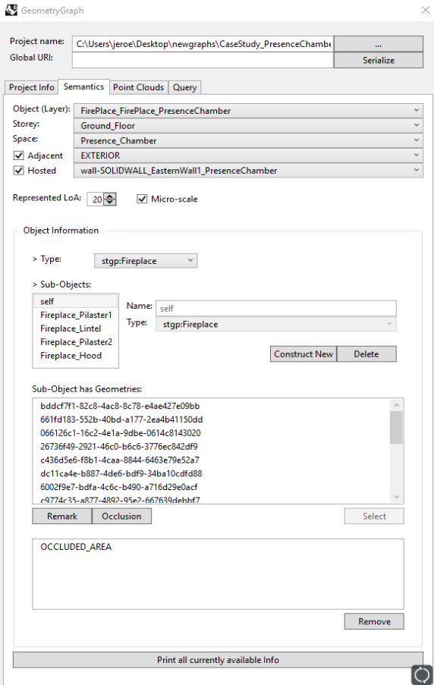
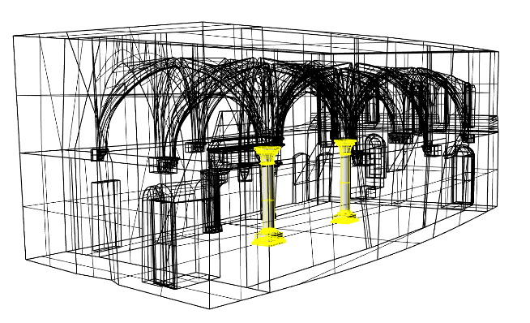
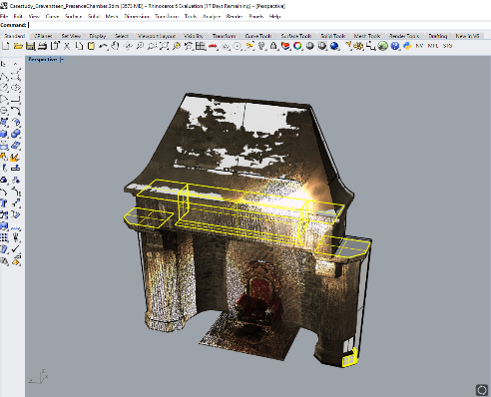
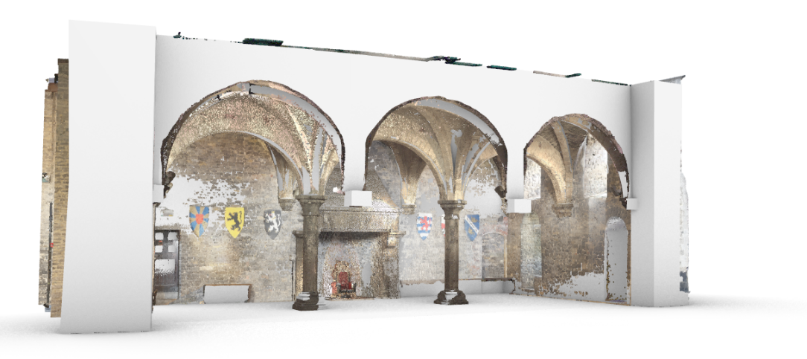
Scan to LBD Graph

Slide 56
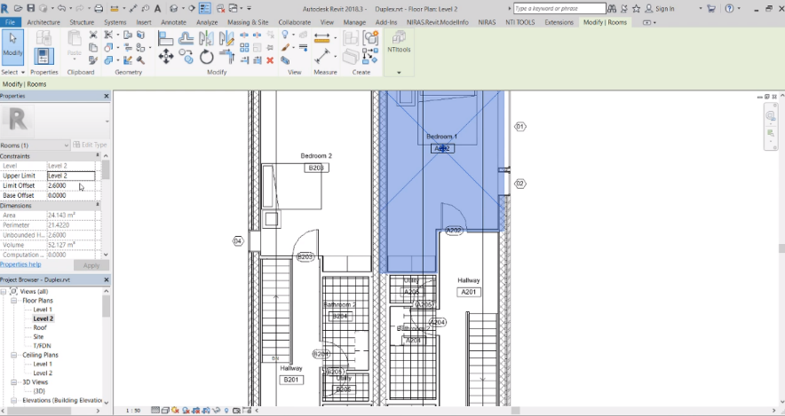
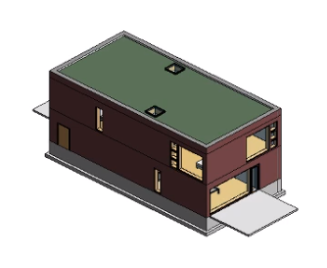
IMPLEMENTATION AT NIRAS using OPM
Open Duplex house in Revit
Use exporter to export it to our server
Use web-viewer to show geometry + properties
Change a property in Revit to demonstrate that only the difference is stored
https://www.youtube.com/watch?v=lWoWjM-xCvY

Slide 57
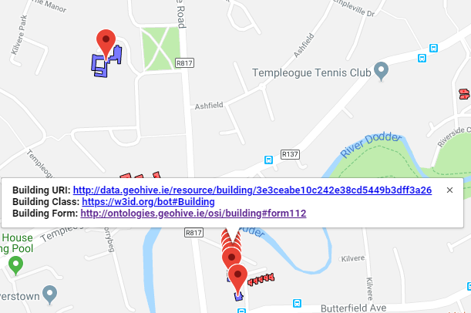
Live Demos: BOT with Added Geospatial
Using BOT to interlink Ordnace Survey Ireland building data (>3.5 million buildings)
Provide a registry of authoratative URI’s for Irish building stock.
http://geovis.adaptcentre.ie/
Username: odef_adapt
Password: geo123
https://www.scss.tcd.ie/~mcglink/video/tutorial/geovis/geovis.html

Slide 58
Questions? (5 mins)

Slide 59
WHERE WE ARE HEADING AT?
Working Group ?
Pushing items to existing groups ?

